Slide 1
Chapter 6: Conditional Processing

Slide 2
Chapter Overview
Boolean and Comparison Instructions
Conditional Jumps
Conditional Loop Instructions
Conditional Structures
Conditional Control Flow Directives

Slide 3
Boolean and Comparison Instructions
What Are Booleans?
• Boolean values are either True or False.
• These are usually represented by 1 for True
and 0 for False.
CPU Status Flags
AND Instruction
OR Instruction
XOR Instruction
NOT Instruction
Applications
TEST Instruction
CMP Instruction

Slide 4
Status Flags - Review
Boolean instructions affect the following flags:
The Zero flag is set when the result of an operation equals zero.
The Carry flag is set when the result of unsigned arithmetic is too large for the destination operand or when subtraction requires a borrow.
The Sign flag is set when the high bit of the destination operand is set indicating a negative result.
The Overflow flag is set when signed arithmetic generates a result which ifs out of range

Slide 5


AND Instruction
The AND instruction performs a bit wise AND operation between corresponding bits in the two operands and places the result in the first operand
Syntax:
    AND destination, source
  (same operand types as MOV)
AND
The AND instruction can be used to clear selected bits in an operand while preserving the remaining bits. This is called masking

Slide 6
Converting Characters to Upper Case
We convert lower case to upper case by clearing bit 5:
  0 1 1 0 0 0 0 1 {‘a’ }
  0 1 0 0 0 0 0 1 {‘A’ }
  .data
  array BYTE 50 DUP(?)
  .code
  mov ecx, LENGTHOF array
  mov esi, OFFSET array
  L1:
  and byte ptr [esi], 11011111b ;masking bit 5
  inc esi
  loop L1

Slide 7
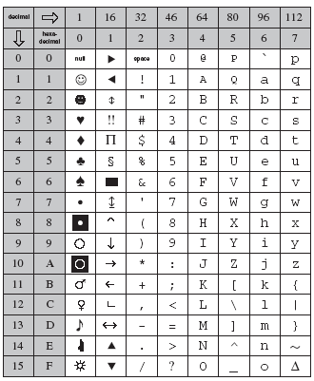

Slide 8


OR Instruction
The OR instruction performs a bit wise OR operation between corresponding bits in the two operands and places the result in the first operand
Syntax:
    OR destination, source
OR
The OR instruction can be used to set selected bits in an operand while preserving the remaining bits

Slide 9
Your Turn …
Converting characters to lower case

Slide 10

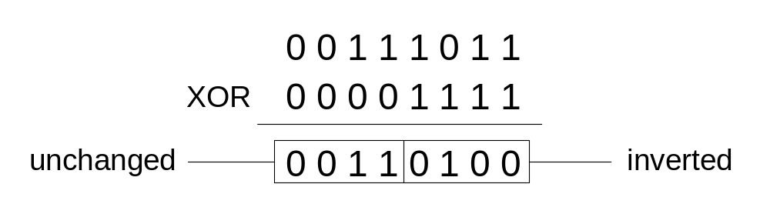
XOR Instruction
The XOR instruction performs a bit wise Exclusive OR operation between corresponding bits in the two operands and places the result in the first operand.
Syntax:
    XOR destination, source
XOR
XOR is a useful way to toggle (invert) the bits in an operand.

Slide 11
Your Turn …
Converting characters: upper case to lower one, and lower case to upper one

Slide 12
AND, OR, XOR and the Status Flags
All three instructions affect the status flags (ZF, SF)
All three instructions could not have two memory operands

Slide 13

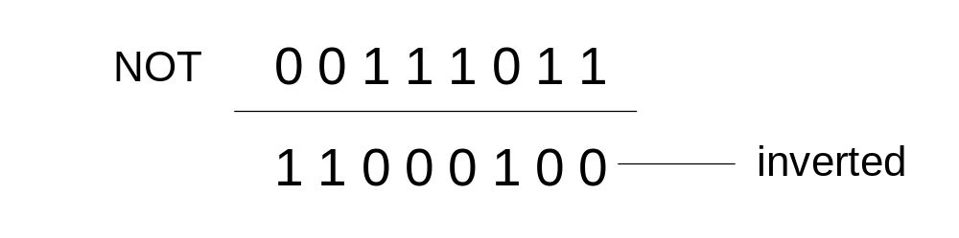
NOT Instruction
The NOT instruction reverse all bits in an Operand
Not change flags
Syntax:
    NOT destination
NOT

Slide 14
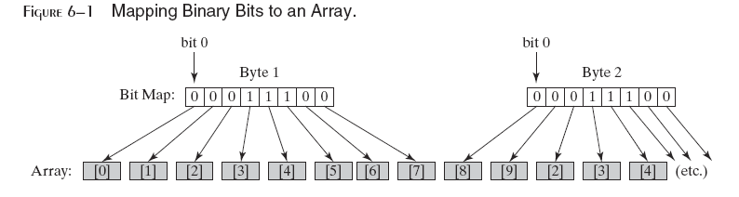
Bit-Mapped Sets
Binary bits indicate set membership
Efficient use of storage
Also known as bit vectors

Slide 15
Bit-Mapped Set Operations
Set Complement
Set Intersection
Set Union
Generate the complement of a set
    mov eax,SetX
    not eax
    mov eax,setX
    and eax,setY
Generate an intersection of two sets
    mov eax,setX
    or eax,setY
Generate a union of two sets

Slide 16
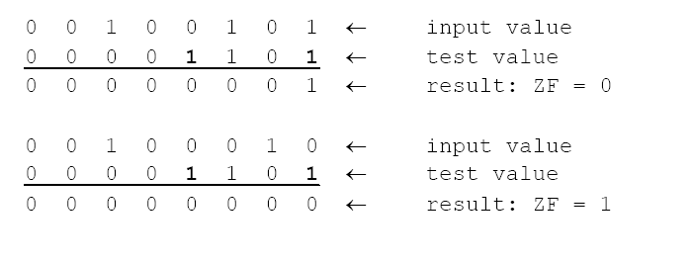
TEST Instruction
The TEST instruction performs an implied AND operation between corresponding bits in the two operands and sets the flags without modifying either operand.
The TEST instruction can check several bits at once.
No operands are modified, but the Zero flag is affected.
If we wanted to know if either bit 0 or bit 3 is set in the
AL register, we can use
test al, 00001001b ; test bits 0 and 3
0
0

Slide 17
CMP Instruction (1 of 3)
The CMP instruction sets the flags as if it had performed subtraction on the operand.
Neither operand is changed.
Syntax: CMP destination, source
Example: destination == source
with unsigned integers:
mov al,5
cmp al,5 ; ZF=1, CF=0
Example: destination < source
mov al,4
cmp al,5 ; ZF=0, CF=1

Slide 18
CMP Instruction (2 of 3)
Example: destination > source
mov al,6
cmp al,5 ; ZF = 0, CF = 0
(both the Zero and Carry flags are clear)

Slide 19
CMP Instruction (3 of 3)
The comparisons shown here are performed with signed integers.
Example: destination > source
mov al,5
cmp al,-2 ; Sign flag == Overflow flag
Example: destination < source
mov al,-1
cmp al,5 ; Sign flag != Overflow flag

Slide 20
What's Next
Boolean and Comparison Instructions
Conditional Jumps
Conditional Loop Instructions
Conditional Structures
Conditional Control Flow Directives

Slide 21
Conditional Jumps
Jumps Based On . . .
  Specific flags
  Equality
  Unsigned comparisons
  Signed Comparisons
Applications
Encrypting a String
Bit Test (BT) Instruction

Slide 22
Jcond Instruction
A conditional jump instruction branches to a label when specific register or flag conditions are met
Specific jumps:
  JB, JC - jump to a label if the Carry flag is set
  JE, JZ - jump to a label if the Zero flag is set
  JS - jump to a label if the Sign flag is set
  JNE, JNZ - jump to a label if the Zero flag is clear
  JECXZ - jump to a label if ECX = 0

Slide 23
Jcond Ranges
Prior to the 386:
  jump must be within –128 to +127 bytes from current location counter
x86 processors:
  32-bit offset permits jump anywhere in memory

Slide 24
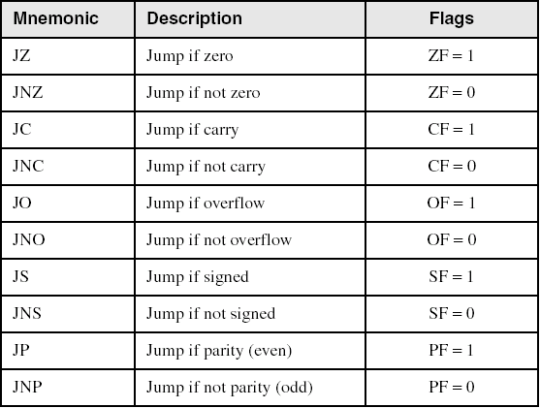
Jumps Based on Specific Flags

Slide 25
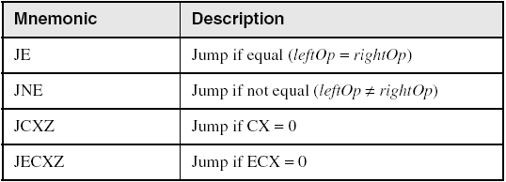
Jumps Based on Equality

Slide 26
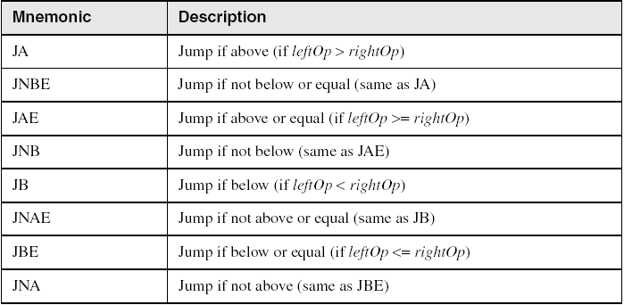
Jumps Based on Unsigned Comparisons

Slide 27
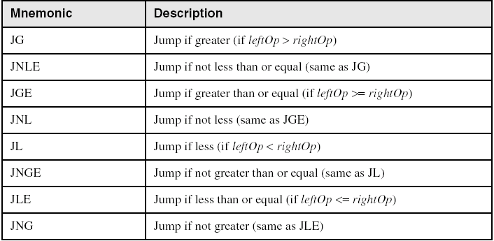
Jumps Based on Signed Comparisons

Slide 28
Applications (1 of 5)
Task: Jump to a label if unsigned EAX is greater than EBX
Solution: Use CMP, followed by JA
cmp eax,ebx
ja Larger
Task: Jump to a label if signed EAX is greater than EBX
Solution: Use CMP, followed by JG
cmp eax,ebx
jg Greater

Slide 29
Applications (2 of 5)
Jump to label L1 if unsigned EAX is less than or equal to Val1
cmp eax,Val1
jbe L1 ; below or equal
Jump to label L1 if signed EAX is less than or equal to Val1
cmp eax,Val1
jle L1

Slide 30
Applications (3 of 5)
Compare unsigned AX to BX, and copy the larger of the two into a variable named Large
  mov Large,bx
  cmp ax,bx
  jna Next
  mov Large,ax
Next:
Compare signed AX to BX, and copy the smaller of the two into a variable named Small
  mov Small,ax
  cmp bx,ax
  jnl Next
  mov Small,bx
Next:

Slide 31
Applications (4 of 5)
Jump to label L1 if the memory word pointed to by ESI equals Zero
  cmp WORD PTR [esi],0
  je L1
Jump to label L2 if the doubleword in memory pointed to by EDI is even
test DWORD PTR [edi],1
jz L2

Slide 32
Applications (5 of 5)
Task: Jump to label L1 if bits 0, 1, and 3 in AL are all set.
Solution: Clear all bits except bits 0, 1,and 3. Then compare the result with 00001011 binary.
and al,00001011b ; clear unwanted bits
cmp al,00001011b ; check remaining bits
je L1 ; all set? jump to L1

Slide 33
Encrypting a String
The following loop uses the XOR instruction to transform every character in a string into a new value.
KEY = 239 ; can be any byte value
.data
buffer BYTE “Attack at dawn.”, 0
.code
  mov ecx,lengthof buffer ; loop counter
  mov esi,0 ; index 0 in buffer
L1:
  xor buffer[esi],KEY ; translate a byte
  inc esi ; point to next byte
  loop L1

Slide 34
String Encryption Program
Tasks:
  Input a message (string) from the user
  Encrypt the message
  Display the encrypted message
  Decrypt the message
  Display the decrypted message
View the Encrypt.asm program's source code. Sample output:
Enter the plain text: Attack at dawn.
Cipher text: «¢¢Äîä-Ä¢-ïÄÿü-Gs
Decrypted: Attack at dawn.

Slide 35
What's Next
Boolean and Comparison Instructions
Conditional Jumps
Conditional Loop Instructions
Conditional Structures
Conditional Control Flow Directives

Slide 36
Conditional Loop Instructions
LOOPZ and LOOPE
LOOPNZ and LOOPNE

Slide 37
LOOPZ and LOOPE
Syntax:
  LOOPE destination
  LOOPZ destination
Logic:
  ECX ← ECX – 1
  if ECX > 0 and ZF=1, jump to destination
Useful when scanning an array for the first element that does not match a given value.
In 32-bit mode, ECX is the loop counter register. In 16-bit real-address mode, CX is the counter, and in 64-bit mode, RCX is the counter.

Slide 38
LOOPNZ and LOOPNE
LOOPNZ (LOOPNE) is a conditional loop instruction
Syntax:
LOOPNZ destination
LOOPNE destination
Logic:
  ECX ← ECX – 1;
  if ECX > 0 and ZF=0, jump to destination
Useful when scanning an array for the first element that matches a given value.

Slide 39
LOOPNZ Example
The following code finds the first positive value in an array:
.data
array SWORD -3,-6,-1,-10,10,30,40,4
sentinel SWORD 0
.code
  mov esi,OFFSET array
  mov ecx,LENGTHOF array
next:
  test WORD PTR [esi],8000h ; test sign bit
  pushfd ; push flags on stack
  add esi,TYPE array
  popfd ; pop flags from stack
  loopnz next ; continue loop
  jnz quit ; none found
  sub esi,TYPE array ; ESI points to value
quit:

Slide 40
Your Turn …
The following code finds the first value 10 in an array:
.data
array SWORD -3,-6,-1,-10,10,30,40,4
sentinel SWORD 0
.code
  mov esi,OFFSET array
  mov ecx,LENGTHOF array
next:
  cmp WORD PTR [esi],10 ; set ZF = 1 if found
  pushfd ; push flags on stack
  add esi,TYPE array
  popfd ; pop flags from stack
  loopnz next ; continue loop
  jnz quit ; none found
  sub esi,TYPE array ; ESI points to value
quit:

Slide 41
What's Next
Boolean and Comparison Instructions
Conditional Jumps
Conditional Loop Instructions
Conditional Structures
Conditional Control Flow Directives

Slide 42
Conditional Structures
Block-Structured IF Statements
Compound Expressions with AND
Compound Expressions with OR
WHILE Loops
Table-Driven Selection

Slide 43
Block-Structured IF Statements
Assembly language programmers can easily translate logical statements written in C++/Java into assembly language. For example:
if( op1 == op2 )
X = 1;
else
X = 2;
  mov eax,op1
  cmp eax,op2
  jne L1
  mov X,1
  jmp L2
L1: mov X,2
L2:

Slide 44
Your turn . . .
Implement the following pseudocode in assembly language. All values are unsigned:
if( ebx <= ecx )
{
eax = 5;
edx = 6;
}
  cmp ebx,ecx
  ja next
  mov eax,5
  mov edx,6
next:
(There are multiple correct solutions to this problem.)

Slide 45
Your turn . . .
Implement the following pseudocode in assembly language. All values are 32-bit signed integers:
if( var1 <= var2 )
var3 = 10;
else
{
var3 = 6;
var4 = 7;
}
  mov eax,var1
  cmp eax,var2
  jle L1
  mov var3,6
  mov var4,7
  jmp L2
L1: mov var3,10
L2:
(There are multiple correct solutions to this problem.)

Slide 46
Compound Expression with AND (1 of 3)
When implementing the logical AND operator, consider that HLLs use short-circuit evaluation
In the following example, if the first expression is false, the second expression is skipped:
if (al > bl) AND (bl > cl)
X = 1;

Slide 47
Compound Expression with AND (2 of 3)
if (al > bl) AND (bl > cl)
X = 1;
This is one possible implementation . . .
cmp al,bl ; first expression...
ja L1
jmp next
L1:
cmp bl,cl ; second expression...
ja L2
jmp next
L2: ; both are true
mov X,1 ; set X to 1
next:

Slide 48
Compound Expression with AND (3 of 3)
if (al > bl) AND (bl > cl)
X = 1;
But the following implementation uses 29% less code by reversing the first relational operator. We allow the program to "fall through" to the second expression:
cmp al,bl ; first expression...
jbe next ; quit if false
cmp bl,cl ; second expression...
jbe next ; quit if false
mov X,1 ; both are true
next:

Slide 49
Your turn . . .
Implement the following pseudocode in assembly language. All values are unsigned:
if( ebx <= ecx
&& ecx > edx )
{
eax = 5;
edx = 6;
}
  cmp ebx,ecx
  ja next
  cmp ecx,edx
  jbe next
  mov eax,5
  mov edx,6
next:
(There are multiple correct solutions to this problem.)

Slide 50
Compound Expression with OR (1 of 2)
When implementing the logical OR operator, consider that HLLs use short-circuit evaluation
In the following example, if the first expression is true, the second expression is skipped:
if (al > bl) OR (bl > cl)
X = 1;

Slide 51
Compound Expression with OR (2 of 2)
if (al > bl) OR (bl > cl)
X = 1;
We can use "fall-through" logic to keep the code as short as possible:
cmp al,bl ; is AL > BL?
ja L1 ; yes
cmp bl,cl ; no: is BL > CL?
jbe next ; no: skip next statement
L1: mov X,1 ; set X to 1
next:

Slide 52
WHILE Loops
A WHILE loop is really an IF statement followed by the body of the loop, followed by an unconditional jump to the top of the loop. Consider the following example:
while( eax < ebx)
eax = eax + 1;
This is a possible implementation:
top: cmp eax,ebx ; check loop condition
jae next ; false? exit loop
inc eax ; body of loop
jmp top ; repeat the loop
next:

Slide 53
Your turn . . .
Implement the following loop, using unsigned 32-bit integers:
while( ebx <= val1)
{
ebx = ebx + 5;
val1 = val1 - 1
}
top: cmp ebx,val1 ; check loop condition
ja next ; false? exit loop
add ebx,5 ; body of loop
dec val1
jmp top ; repeat the loop
next:

Slide 54
What's Next
Boolean and Comparison Instructions
Conditional Jumps
Conditional Loop Instructions
Conditional Structures
Conditional Control Flow Directives

Slide 55
Conditional Control Flow Directives
.BREAK | .CONTINUE | .ELSE
.ELSEIF | .ENDIF | .ENDW
.IF | .REPEAT | .UNTIL
.UNTILCXZ | .WHILE

Slide 56
Creating IF Statements
Runtime Expressions
Relational and Logical Operators
MASM-Generated Code
.REPEAT Directive
.WHILE Directive

Slide 57
Runtime Expressions
.IF, .ELSE, .ELSEIF, and .ENDIF can be used to evaluate runtime expressions and create block-structured IF statements.
Examples:
These expressions are evaluated at runtime.
.IF eax > ebx
mov edx,1
.ELSE
mov edx,2
.ENDIF
.IF eax > ebx && eax > ecx
mov edx,1
.ELSE
mov edx,2
.ENDIF
MASM generates "hidden" code for you (in the background, which appears in the output listing file .lst), consisting of code labels, CMP and conditional jump instructions.

Slide 58
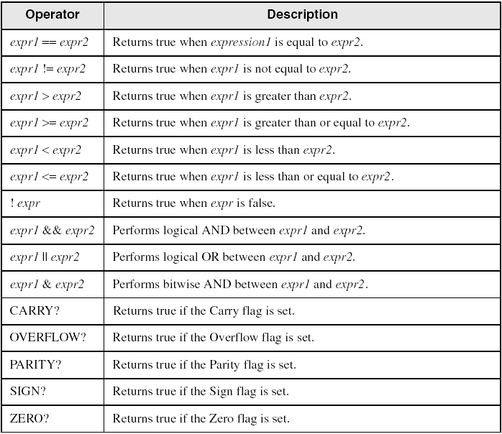
Relational and Logical Operators

Slide 59
Signed and Unsigned Comparisons
.data
val1 DWORD 5
result DWORD ?
.code
mov eax,6
.IF eax > val1
mov result,1
.ENDIF
Generated code:
mov eax,6
cmp eax,val1
jbe @C0001
mov result,1
@C0001:
MASM automatically generates an unsigned jump (JBE) because val1 is unsigned.

Slide 60
Signed and Unsigned Comparisons
.data
val1 SDWORD 5
result SDWORD ?
.code
mov eax,6
.IF eax > val1
mov result,1
.ENDIF
Generated code:
mov eax,6
cmp eax,val1
jle @C0001
mov result,1
@C0001:
MASM automatically generates a signed jump (JLE) because val1 is signed.

Slide 61
Signed and Unsigned Comparisons
.data
result DWORD ?
.code
mov ebx,5
mov eax,6
.IF eax > ebx
mov result,1
.ENDIF
Generated code:
mov ebx,5
mov eax,6
cmp eax,ebx
jbe @C0001
mov result,1
@C0001:
MASM automatically generates an unsigned jump (JBE) when both operands are registers . . .

Slide 62
Signed and Unsigned Comparisons
.data
result SDWORD ?
.code
mov ebx,5
mov eax,6
.IF SDWORD PTR eax > ebx
mov result,1
.ENDIF
Generated code:
mov ebx,5
mov eax,6
cmp eax,ebx
jle @C0001
mov result,1
@C0001:
. . . unless you prefix one of the register operands with the SDWORD PTR operator. Then a signed jump is generated.

Slide 63
.REPEAT Directive
Executes the loop body before testing the loop condition associated with the .UNTIL directive.
Example:
; Display integers 1 – 10:
mov eax,0
.REPEAT
inc eax
call WriteDec
call Crlf
.UNTIL eax == 10
.repeat and .while directives offer alternatives to writing loops with cmp and conditional jump instructions

Slide 64
.WHILE Directive
Tests the loop condition before executing the loop body The .ENDW directive marks the end of the loop.
Example:
; Display integers 1 – 10:
mov eax,0
.WHILE eax < 10
inc eax
call WriteDec
call Crlf
.ENDW

